Slide 1
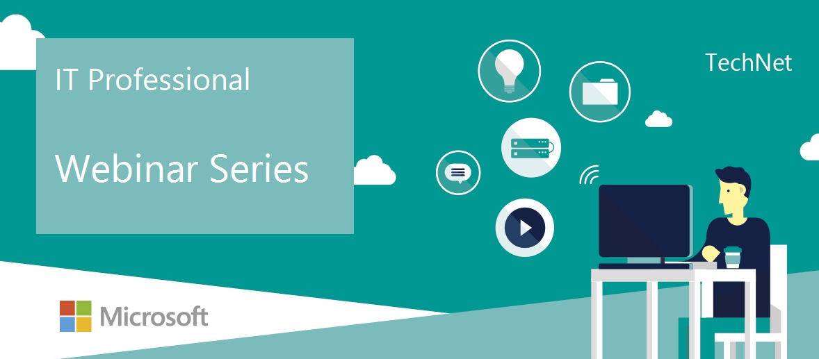
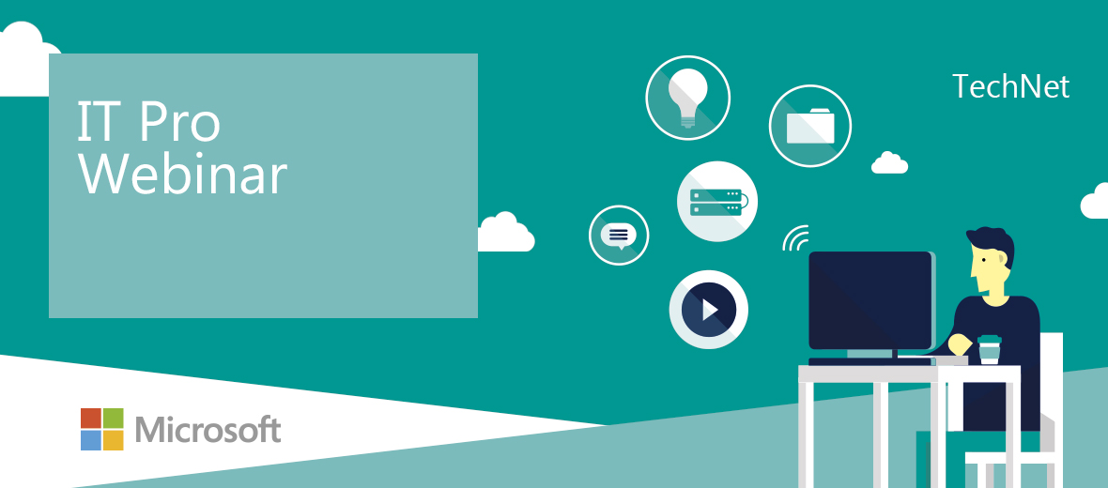
Welcome
Welcome

Slide 2


Onboarding to OMS - Get the job done with Azure Automation
March 14 2016
Stijn Callebaut
Consultant

Slide 3
Stay in touch with IT Professional community
Follow us
@technetbelux
All events
http://aka.ms/itprobesmart
IT Camp Hybrid Cloud | 21/03/2016 | 9:00 AM
Onboarding to OMS: Get the job done with Azure Automation | 14/03/2016 | 10:00 AM
Securely publishing your in-house web applications in a hybrid scenario | 18/03/2016 | 10:00 AM
Onboarding to OMS: Recover your Datacenter in the cloud with Azure Site Recovery | 21/03/2016 | 10:00 AM
Hybrid Sharepoint | 25/03/2016 | 10:00 AM
Onboarding to OMS: Cloud Integrated Backup with Microsoft System Center and Azure Backup (To be defined, I have two people who want to provide the session) | 28/03/2016 | 10:00 AM
Onboarding to OMS: Configuration management with Azure Automation | 4/04/2016 | 10:00 AM
Hybrid Identity & access management obv Azure AD Premium | 4/04/2016 | 2:00 PM
Windows 10 and Configuration Manager “Windows 10 in the enterprise” | 8/04/2016 | 10:00 AM
Gathering and visualizing cloud data with Microsoft Power BI | 11/04/2016 | 10:00 AM
Cloud PBX | 29/04/2016 | 10:00 AM

Slide 4

What's new in Hybrid IT Infrastructure – IT Camp - March 21
Sign up: http://aka.ms/itcampbe

Slide 5

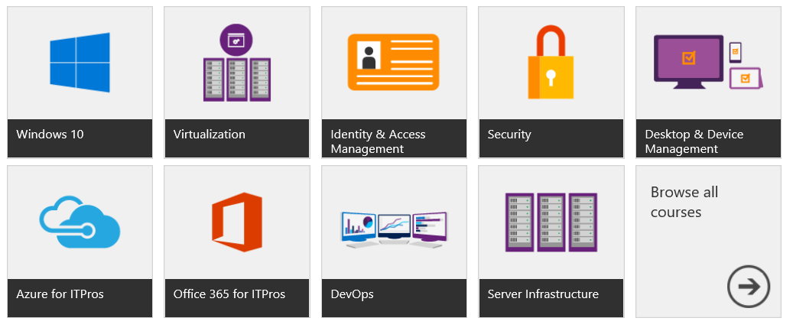
www.microsoftvirtualacademy.com

Slide 6
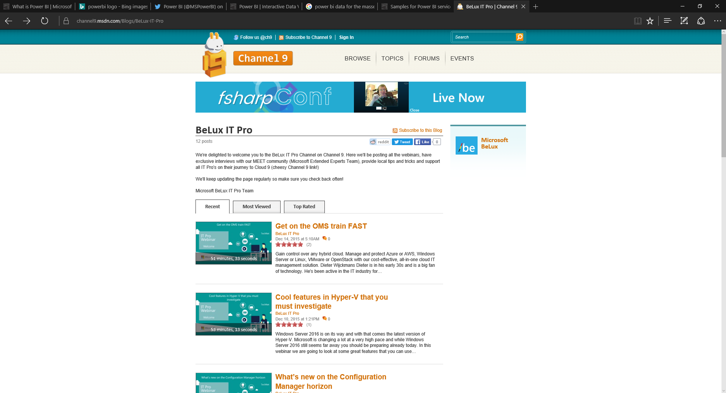
All webinars are available after this session on Channel 9
http://aka.ms/BeLuxITPRO

Slide 7

Thank you

